Slide 1
Chapter no 4 Software testing & Software Quality
Pressman’s definition suggests three requirements for quality assurance that are to be met by the developer:
Specific functional requirements, which refer mainly to the outputs of the software system.
The software quality standards mentioned in the contract.
In effect, Pressman’s definition provides operative directions for testing the degree to which the reqrequirements are met.

Slide 2
Software quality:
1) Conformance to specification: Quality that is defined as a matter of products and services whose measurable characteristics satisfy a fixed specification
2) Meeting customer needs: Quality that is identified independent of any measurable characteristics. That is, quality is defined as the products or services capability to meet customer expectations – explicit or not.
Software quality is a multidimensional quantity and is measurable.
To do this, we need to divide and measure software quality in terms of quality
attributes:
Static Quality Attributes
Dynamic Quality Attributes

Slide 3
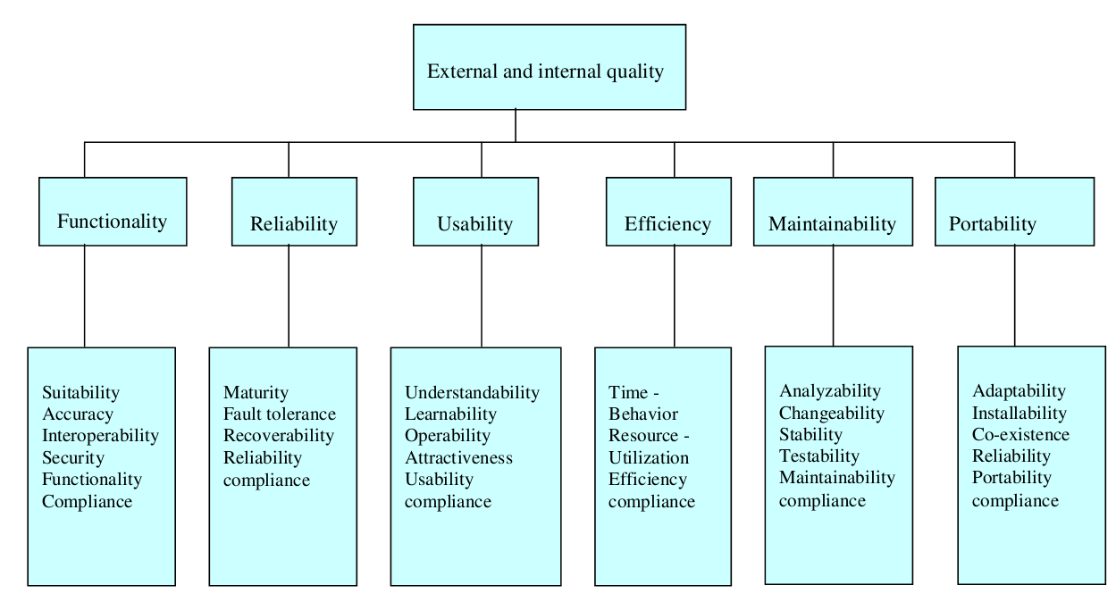

Slide 4
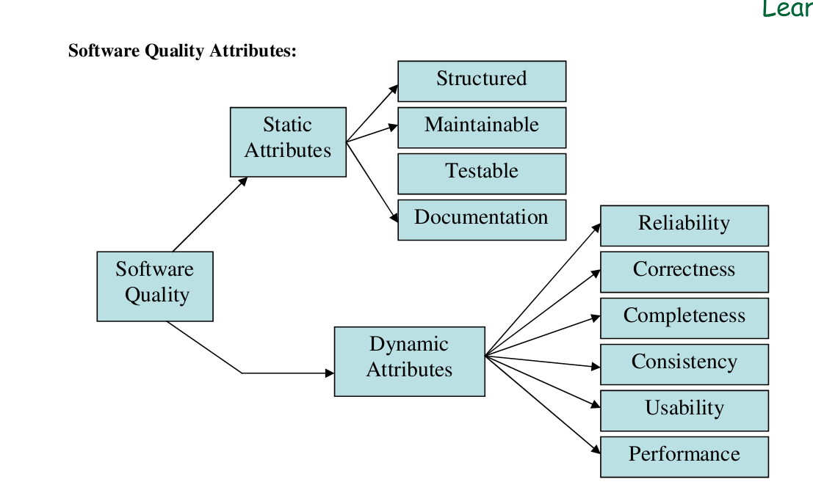

Slide 5
Requirement, Behavior and Correctness:
Requirements specify the "function or characteristic of a system that is necessary for the
verifiable behaviors that a system must possess and constraints that a
system must work within to satisfy an organization's objectives and solve a set of
problems".
The documented representation of requirement is requirement specification.
The review of requirement specification involves
- Arriving at Team understanding of the Requirements and
- Reviewing Requirements Specification document to determine Quality Attributes
Step 1#Arriving at Team understanding of the Requirements
- Delivering Quality Product means meeting Stake Holders expectations.
- Needs review of requirements and understanding by relevant stake holders on
acceptance
Step2#Review Requirements Specification document to determine Quality Attributes
- Complete: Nothing is missing
- Consistent: Does not conflict with other requirements
- Correct: Accurately states a customer need
- Feasible: Can be implemented within known constraints
- Modifiable: Can be easily changed
- Necessary: Documents something customers really need
- Prioritized: Ranked as to importance of inclusion in product
- Testable: Tests can be devised to demonstrate correct implementation
- Traceable: Linked to system requirements, and to designs, code, and tests
- Unambiguous: Has only one possible meaning

Slide 6
Software quality assurance vs. software quality control
The main objective of quality assurance is to minimize the cost of guaranteeing quality by a variety of activities performed throughout the development and manufacturing processes/stages.
These activities prevent the causes of errors, and detect and correct them early in the development process.
Quality control is defined as “a set of activities designed to evaluate the quality of a developed or manufactured product” (IEEE, 1991); in other words, activities whose main objective is the withholding of any product that does not qualify. Accordingly, quality control inspection and other activities take place as the development or manufacturing of the product is completed yet before the product is shipped to the client

Slide 7
Traditional definition of quality:
fitness of purpose,
a quality product does exactly what the users want it to do.
For software products,
fitness of purpose:
satisfaction of the requirements specified in SRS document.

Slide 8
Test Case Development
A test case is a detailed procedure that fully tests a feature or an aspect of a feature. While the
test plan describes what to test, a test case describes how to perform a particular test. You need
to develop test cases for each test listed in the test plan.
General Guidelines
As a tester, the best way to determine the compliance of the software to requirements is by
designing effective test cases that provide a thorough test of a unit. Various test case design
techniques enable the testers to develop effective test cases. Besides, implementing the design
techniques, every tester needs to keep in mind general guidelines that will aid in test case
design:
a. The purpose of each test case is to run the test in the simplest way possible. [Suitable
techniques - Specification derived tests, Equivalence partitioning]
b. Concentrate initially on positive testing i.e. the test case should show that the software does
what it is intended to do. [Suitable techniques - Specification derived tests, Equivalence
partitioning, State-transition testing]
c. Existing test cases should be enhanced and further test cases should be designed to show
that the software does not do anything that it is not specified to do i.e. Negative Testing [Suitable
techniques - Error guessing, Boundary value analysis, Internal boundary value testing, State-transition testing]
d. Where appropriate, test cases should be designed to address issues such as performance,
safety requirements and security requirements [Suitable techniques - Specification derived tests]
e. Further test cases can then be added to the unit test specification to achieve specific test
coverage objectives. Once coverage tests have been designed, the test procedure can be
developed and the tests executed [Suitable techniques - Branch testing, Condition testing, Data
definition-use testing, State-transition testing]

Slide 9
Difference between quality assurance and quality control
?

Slide 10
CHAPTER NO 5
Test case design techniques
Black box testing (functional testing)
a. specification derived tests
b. equivalence partitioning
c. boundary value analysis
White box testing(structural testing)
a. Branch testing
b. condition testing
c. Data definition
d. Internal boundary value testing

Slide 11
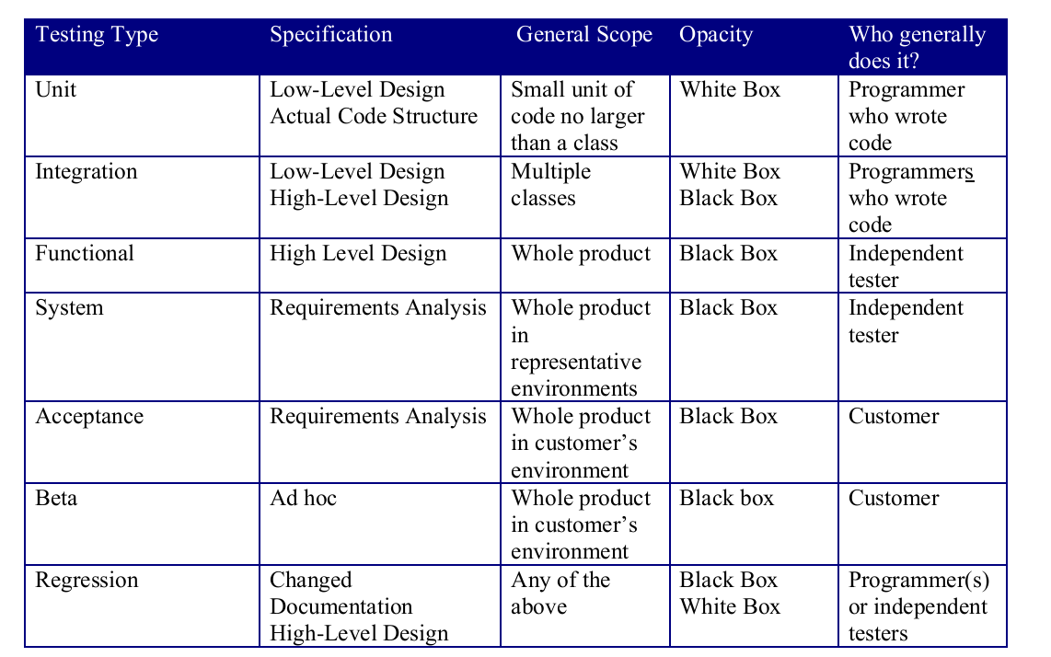

Slide 12
1. Unit Testing
Opacity: White box testing
Specification: Low-level design and/or code structure
Unit testing is the testing of individual hardware or software units or groups of related units . Using white box testing techniques, testers (usually the developers creating the code implementation) verify that the code does what it is intended to do at a very low structural level. For example, the tester will write some test code that will call a method with certain parameters and will ensure that the return value of this method is as expected. Looking at the code itself, the tester might notice that there is a branch (an if-then) and might write a second test case to go down the path not executed by the first test case.
When available, the tester will examine the low-level design of the code; otherwise, the tester will examine the structure of the code by looking at the code itself. Unit testing is generally done within a class or a component.
2. Integration testing
Opacity: Black- and white-box testing
Specification: Low- and high-level design
Integration testis testing in which software components, hardware components, or both
are combined and tested to evaluate the interaction between them. Using both black
and white box testing techniques, the tester (still usually the software developer) verifies that units work together when they are integrated .

Slide 13
3. Functional and system testing
Opacity: Black-box testing
specification: high-level design, requirements specification
Using black box testing techniques, testers examine the high-level design and the
customer requirements specification to plan the test cases to ensure the code does what it
is intended to do. Functional testing involves ensuring that the functionality specified in
the requirement specification works. System testing involves putting the new program in
many different environments to ensure the program works in typical customer
environments with various versions and types of operating systems and/or applications.
System testing is testing conducted on a complete, integrated system to evaluate the
system compliance with its specified requirements . Because system test is done with
a full system implementation and environment, several classes of testing can be done that
can examine non-functional properties of the system. It is best when function and system
testing is done by an unbiased, independent perspective (e.g. not the programmer) .
e.g. stress testing, performance testing,usability testing.
4. Acceptance testing
Opacity: Black-box testing
Specification: requirements specification
5. Regression testing
Opacity: Black- and white-box testing
Specification: Any changed documentation, high-level design

Slide 14
The following guidelines should be used when choosing a set of regression tests (also referred to as the regression test suite):
• Choose a representative sample of tests that exercise all the existing software
functions;
• Choose tests that focus on the software components/functions that have been
changed; and
• Choose additional test cases that focus on the software functions that are most
likely to be affected by the change.

Slide 15
6. Beta testing
Opacity: Black-box testing
Specification: None.
When an advanced partial or full version of a software package is available, the
development organization can offer it free to one or more (and sometimes thousands)
potential users or beta testers. These users install the software and use it as they wish,
with the understanding that you will report any errors revealed during usage back to the
development organization. These users are usually chosen because they are experienced
users of prior versions or competitive products. The advantages of running beta tests are
as follows
• Identification of unexpected errors because the beta testers use the software in
unexpected ways.
• A wider population search for errors in a variety of environments (different
operating systems with a variety of service releases and with a multitude of other
applications running).
• Low costs because the beta testers generally get free software
The disadvantages of beta testing are as follows :
• Lack of systematic testing because each user uses the product in any manner they
choose.
• Low quality error reports because the users may not actually report errors or may
report errors without enough detail.
• Much effort is necessary to examine error reports particularly when there are
many beta testers.

Slide 16
Black box testing, also called functional testing and behavioral testing, focuses on determining whether or not a program does what it is supposed to do based on its functional requirements. Black box testing attempts to find errors in the external behavior of the code in the following categories incorrect or missing functionality; interface errors; errors in data structures used by interfaces;
behavior or performance errors; initialization and termination errors. Through this testing, we can determine if the functions appear to work according to specifications. However, it is important to note that no amount of testing can demonstrate the absence of errors and defects in your code.
It is best if the person who plans and executes black box tests is not the programmer of the code and does not know anything about the structure of the code. The programmers of the code are likely to test that the program does what they programmed it to do. What are needed are tests to make sure that the program does what the customer wants it to do. As a result, most organizations have independent testing groups to perform black box testing. These testers are not the developers and are often referred to as third-party testers. Testers should just be able to understand and specify what the desired output should be for a given input into the program as shown in fig

Slide 17
